Slide 1


BIKE SHARING
DEMAND ANALYSIS &
FLEET OPTIMIZATION
NEXTHIKES IT SOLUTIONS
REPRESENT BY: Panchanana Nayak

Slide 2
Executive summary
RECORDS ANALYSED
RENTAL COUNT
AVG. RENTALS / RECORD
REGISTERED SHARE
1,000
58,304
58.3
91.6%
• Registered customers generate the large majority of rentals in the analysed records.
• Demand changes sharply by hour; early morning is typically quiet and commute periods are stronger.
• Clearer weather is associated with higher average rentals than rain or snow conditions.
• Use these findings to plan fleet availability, maintenance windows and customer campaigns.
NEXTHIKES • BIKE RENTAL ANALYSIS 02 / 15

Slide 3
Project scope & business questions
• Goal: understand when bikes are rented, who rents them, and how weather relates to demand.
• Workbook includes raw input tabs, a cleaned analytical table, and summary tabs for daily, hourly, weather, user type, season, month and correlation.
• Core questions: When is demand highest? Which user group dominates? Does weather matter? Which factors deserve operational attention?
• Outputs: descriptive statistics, visual comparisons, data-quality notes and actionable recommendations.
ANALYSIS FLOW
Raw datasets
↓
Join & clean
↓
Feature engineering
↓
Summaries & charts
↓
Recommendations
NEXTHIKES • BIKE RENTAL ANALYSIS 03 / 15

Slide 4
Data preparation & quality
What was prepared in the Excel workflow
• Cleaned table contains 1,000 rows and 28 fields (including time, weather, users and derived measures).
• Source README states datasets were joined on the shared instant ID and a further dataset appended.
• A helper Unnamed: 0 column was removed; duplicate IDs were checked; missing feels-like temperature values were interpolated.
• Standardized labels and added readable features: month/season names, weekday, day type, hour group, temperature units and user shares.
• Important scope note: the cleaned table covers 1 Jan–14 Feb 2011 in the supplied workbook, so conclusions describe this subset—not a full-year trend.
NEXTHIKES • BIKE RENTAL ANALYSIS 04 / 15

Slide 5
Dataset snapshot & key metrics
Baseline measures from the cleaned data
TOTAL RENTALS
REGISTERED RENTALS
CASUAL RENTALS
UNIQUE DATES
58,304
53,383
4,921
45
• Registered users account for 91.6% of recorded rentals; casual users account for 8.4%.
• Average demand is 58.3 rentals per hourly record.
• The total is the sum of the cleaned records; it should not be interpreted as the full business total unless the source scope is confirmed.
NEXTHIKES • BIKE RENTAL ANALYSIS 05 / 15

Slide 6
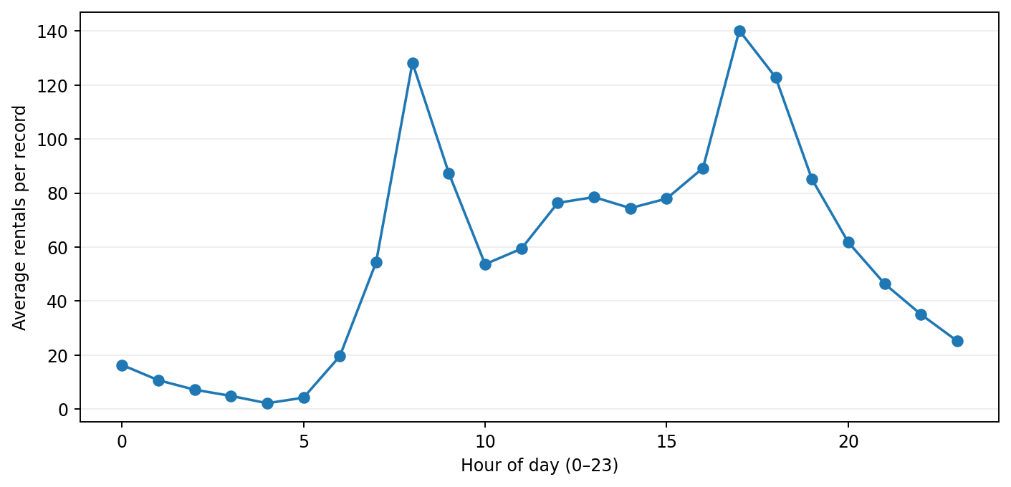
Hourly demand pattern
Average rentals by hour of day
• Highest average hour in the cleaned subset: 17:00.
• Lowest average hour in the cleaned subset: 04:00.
• Demand is not uniform across the day—hour-based planning can improve bike availability.
• Operational use: position bikes before high-demand windows and schedule routine maintenance during quieter periods.
NEXTHIKES • BIKE RENTAL ANALYSIS 06 / 15

Slide 7
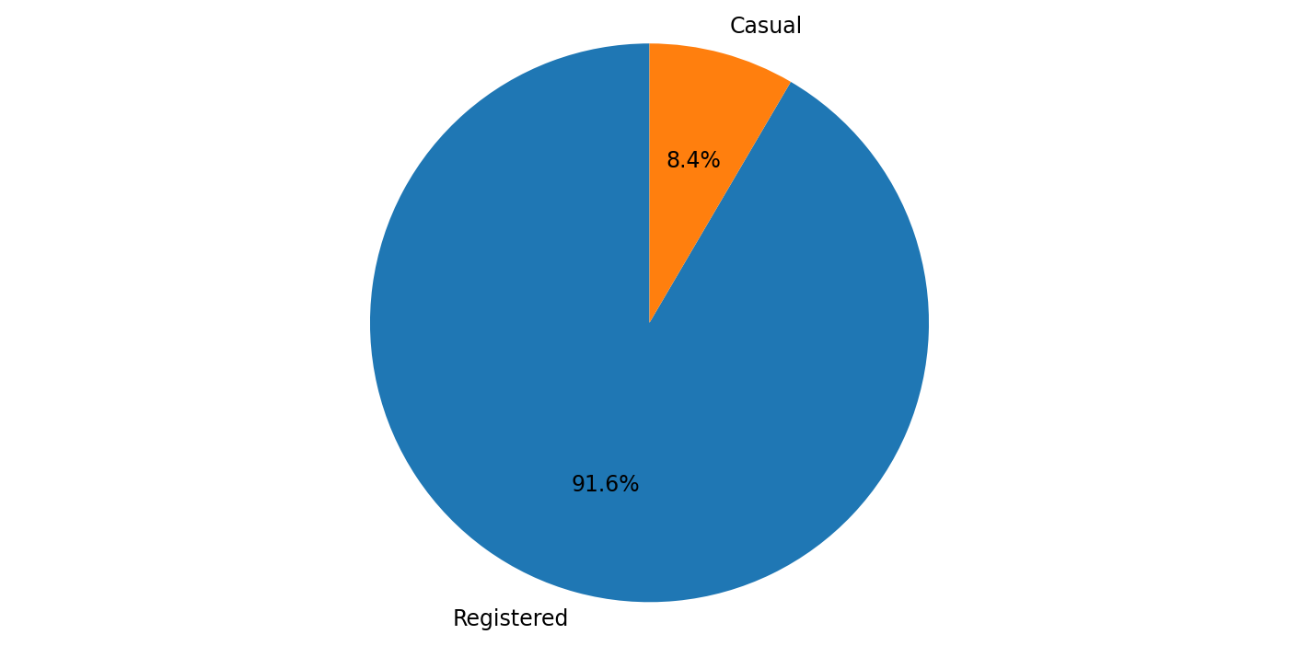
Customer mix: registered vs casual
Rental volume by user type
• Registered: 53,383 rentals (91.6%).
• Casual: 4,921 rentals (8.4%).
• Registered users form the core demand base in this subset.
• Opportunity: use casual-user promotions and simple membership conversion offers, while protecting service quality for repeat users.
NEXTHIKES • BIKE RENTAL ANALYSIS 07 / 15

Slide 8
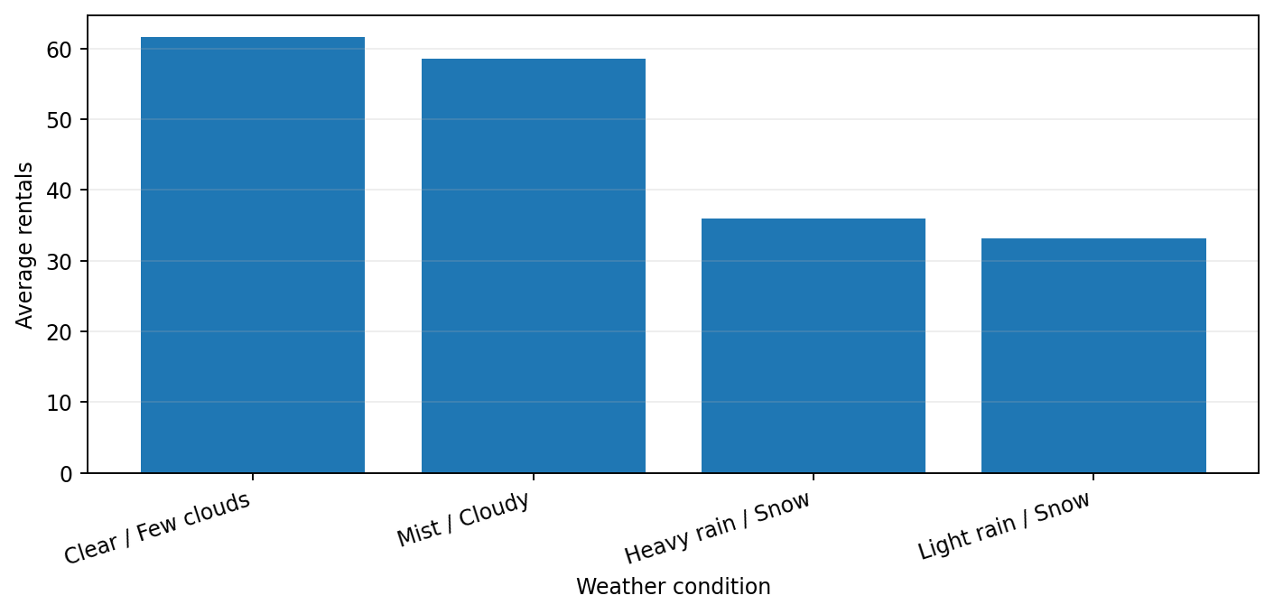
Weather and rental demand
Average rentals vary by observed weather category
• Highest average category in the cleaned data: Clear / Few clouds.
• Lowest average category in the cleaned data: Light rain / Snow.
• Rain/snow categories generally show lower average demand than clear conditions.
• Use weather forecasts for short-term staffing and fleet positioning; treat weather as one influence, not proof of causation.
NEXTHIKES • BIKE RENTAL ANALYSIS 08 / 15

Slide 9
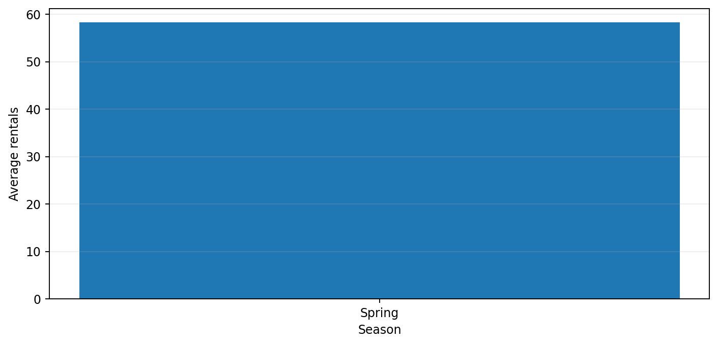
Seasonal comparison
Interpret carefully: the supplied cleaned subset is limited
• The workbook’s Season_Summary reports only Spring in the displayed cleaned subset.
• A reliable four-season ranking cannot be inferred from a dataset covering only part of January and February.
• Recommendation: rerun this comparison after including all months and validating the season mapping.
• For a complete annual analysis, compare both total rentals and average rentals per hour/record.
NEXTHIKES • BIKE RENTAL ANALYSIS 09 / 15

Slide 10
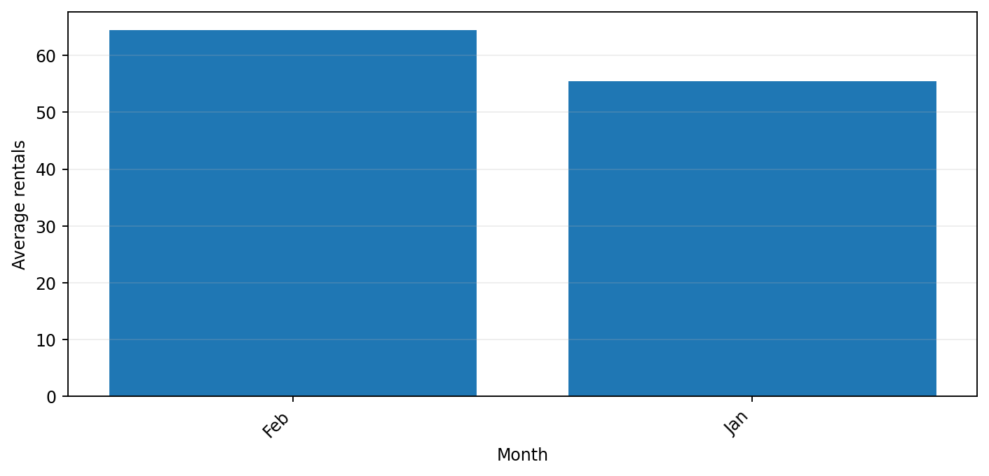
Monthly view
• The provided cleaned data contains January and part of February 2011.
• Compare month-level totals only when the months have comparable coverage; a partial month can look artificially low.
• For a fair comparison, use average rentals per day or compare complete months only.
• Use monthly reporting to support seasonal staffing, budget planning and campaign calendars once a full-year dataset is available.
NEXTHIKES • BIKE RENTAL ANALYSIS 10 / 15

Slide 11
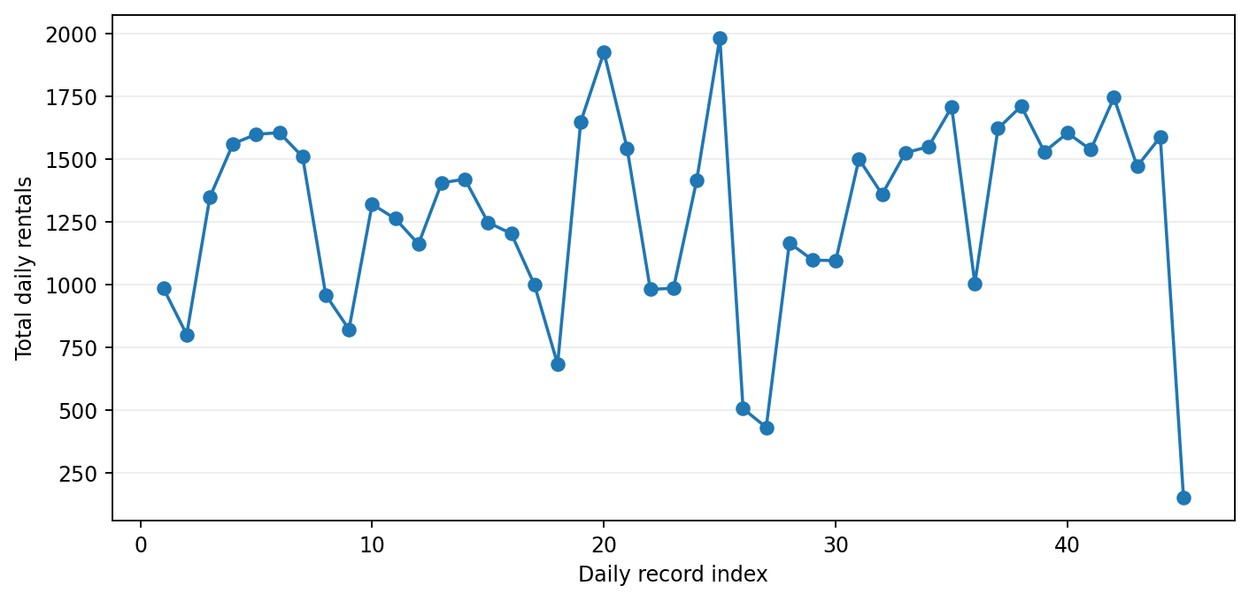
Daily demand variability
Daily totals reveal spikes and quieter days
• Highest daily total in the summary: 1,985 on 25 Jan 2011.
• Lowest daily total in the summary: 151 on 14 Feb 2011.
• Day-to-day changes can reflect weather, weekday/weekend mix and the number of records captured.
NEXTHIKES • BIKE RENTAL ANALYSIS 11 / 15

Slide 12
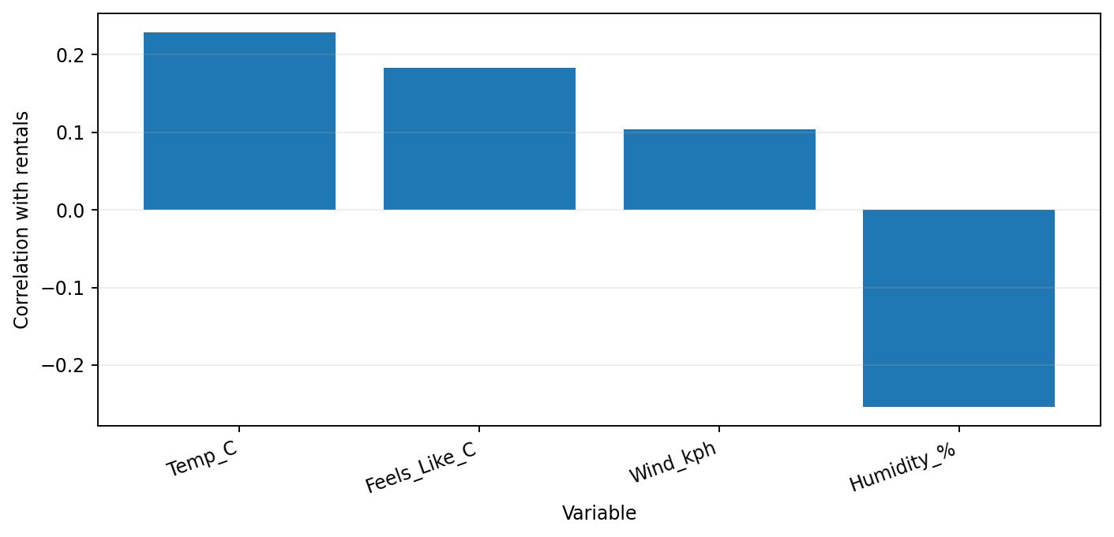
Weather variables & correlation
Linear association with total rentals in cleaned records
• Temperature correlation: 0.23.
• Humidity correlation: -0.25.
• Wind speed correlation: 0.10.
• Correlation describes linear association only; it does not prove that weather caused a change in rentals.
• A broader dataset and multivariable analysis would help separate weather effects from hour, date and user behaviour.
NEXTHIKES • BIKE RENTAL ANALYSIS 12 / 15

Slide 13
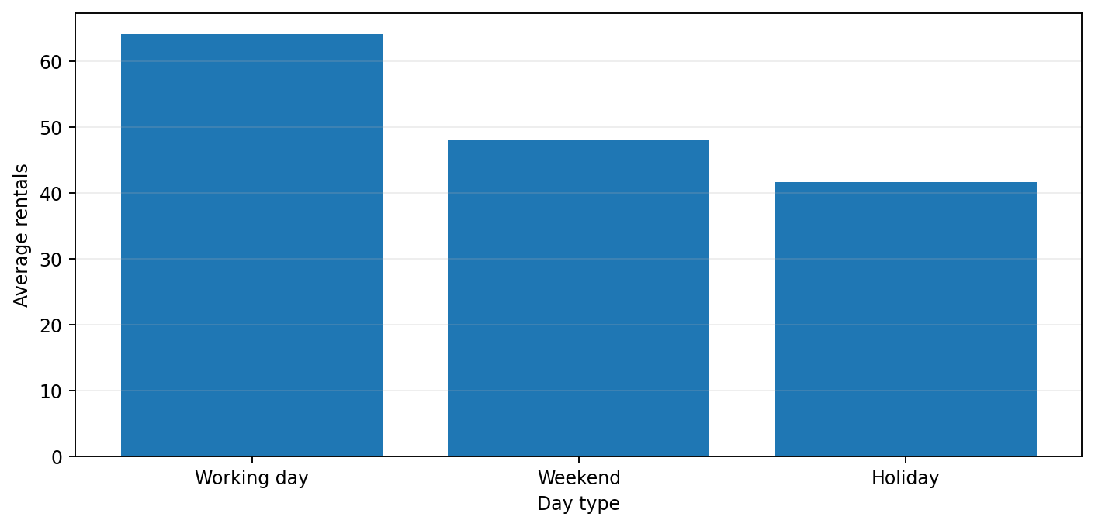
Working day vs weekend
• Higher average demand in this subset: Working day.
• Day type can help determine where to stage bikes and how many support staff are needed.
• Interpret with care: the partial date range may over-represent some weekdays or weekends.
• Next step: compare by weekday, hour and user type together rather than using a single overall average.
NEXTHIKES • BIKE RENTAL ANALYSIS 13 / 15

Slide 14
Business recommendations
• Fleet planning: use hourly demand curves to position bikes before recurring peaks.
• Maintenance: schedule routine work in the lowest-demand hours, keeping emergency capacity available.
• Customer growth: test casual-to-registered conversion offers and measure conversion rate—not just clicks.
• Weather response: use forecasts for short-term staffing and service alerts; avoid overreacting to one unusual day.
• Reporting: track rentals per available bike, utilization, failed rental attempts, revenue and customer retention.
• Validation: refresh analysis with complete-year data before making seasonal or long-term investment decisions.
NEXTHIKES • BIKE RENTAL ANALYSIS 14 / 15

Slide 15
CONCLUSION & NEXT STEPS
The data provides a useful first view of bike-rental behaviour—but coverage matters.
• Registered users dominate recorded rental volume.
• Demand varies by hour and weather category.
• Daily and user-type summaries can support operational planning.
• Extend the dataset across a full year, validate all categories, and rerun the same dashboard for stronger decisions.
THANK YOU
Source: supplied Nexthikes Excel workbook • Analysis limited to values present in the workbook

